Slide 1
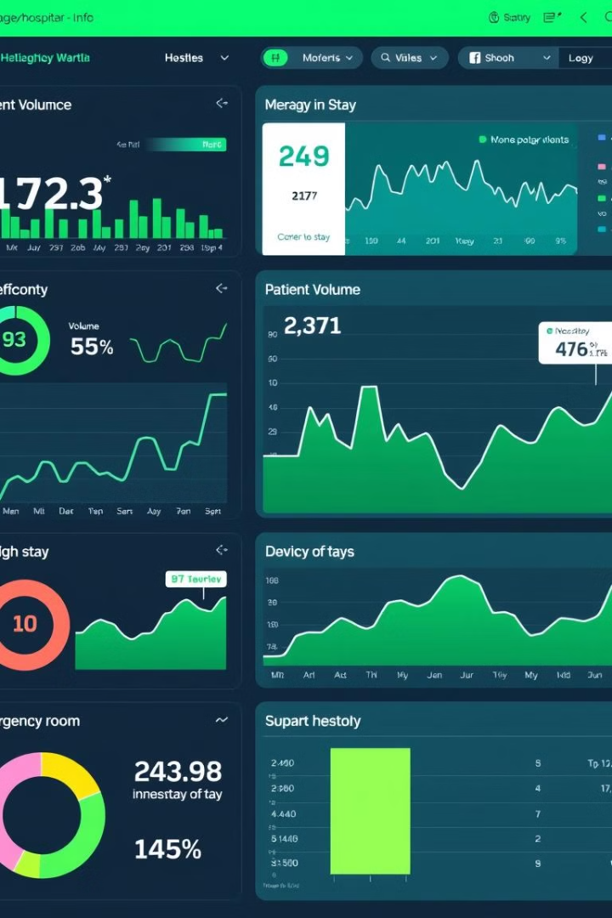
Hospital Data Analysis
A hospital dashboard provides a centralized view of critical performance indicators, enabling informed decision-making and operational efficiency.
by Roshan Madake
Guided by Prof. Sumit Sir

Slide 2
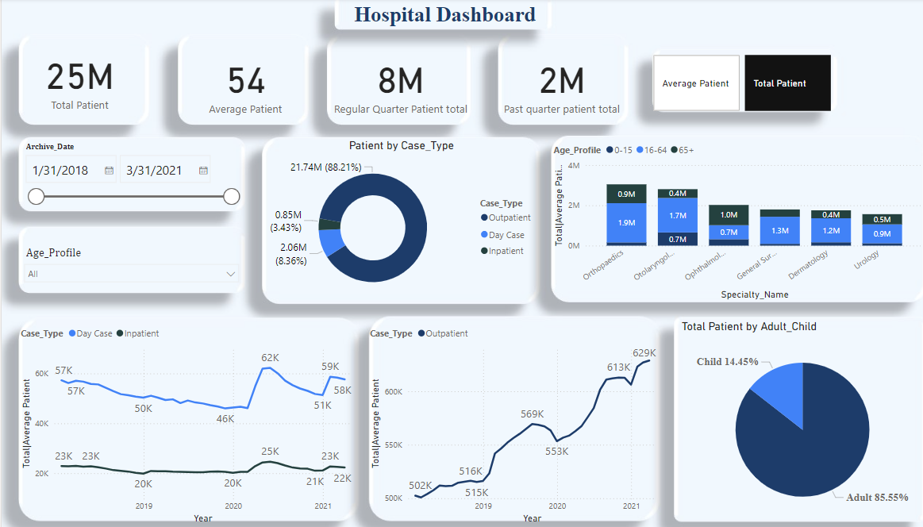

Slide 3
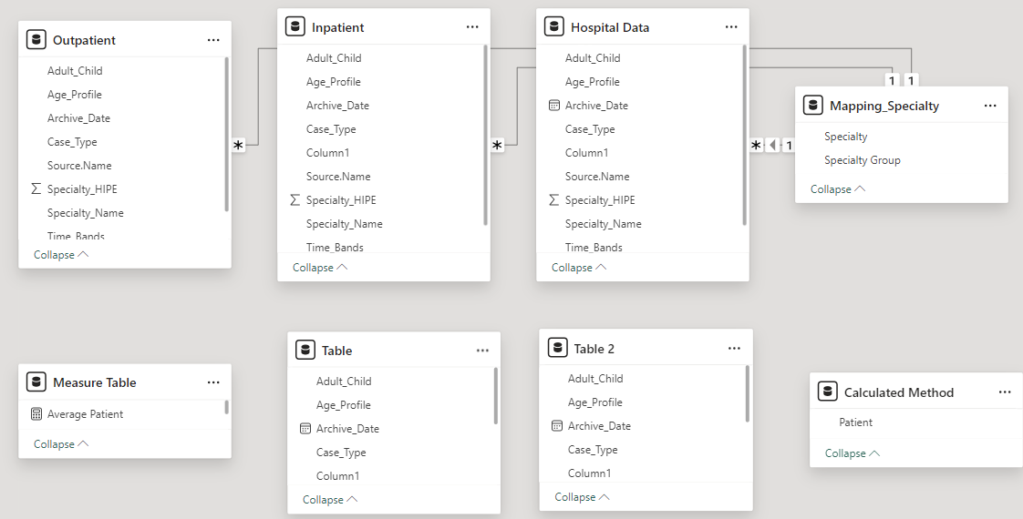
Data Modelling

Slide 4
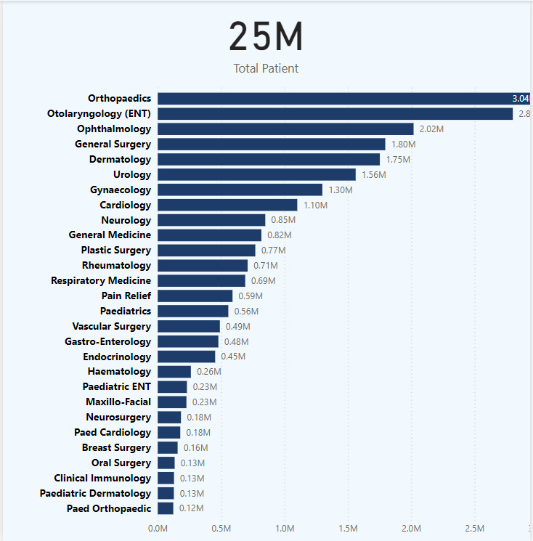
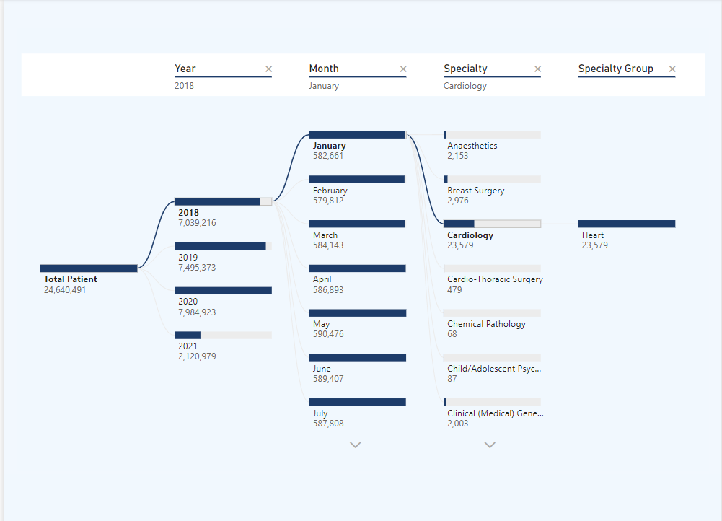
ToolTip
Decision Tree

Slide 5
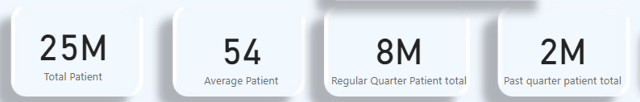
Measures
1
Total Patient
2
Average Patient
Total number of Patients admitted to the hospital.
Tracks the number of average patients
3
Regular Quarter Patient Total
4
Past Quarter Patient Total
Indicates the current frequency of quarterwise patients.
Tracks the number of patients visited in the past quarter

Slide 6



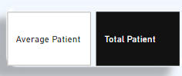
Slicers
Timeline Slicer
The timeline slicer in our hospital dashboard allows users to filter and analyze data over a specified time period.
Age Profile Slicer
The Age Profile slicer allows users to filter the dashboard data by specific age groups.
Average vs Total Patient
Shows the average length of stay for The Average vs. Total Patient Slicer provides users with the ability to toggle between viewing data as averages or totals.

Slide 7
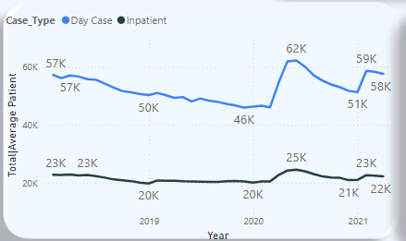
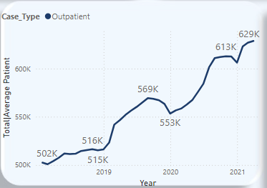
Patient Volume Trends
1
Daily Admissions
Tracks the number of patients admitted each day, providing insights into demand patterns.
2
Inpatient
Shows the number of patients admitted each year, reflecting overall patient flow.
3
Outpatient Patient Demographics
Analyzes changes in outpatient demographics over the years.

Slide 8

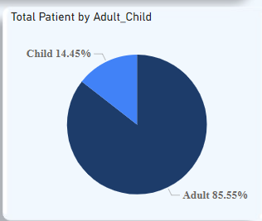
Patient Distribution by
Age Group: Adults vs. Children
The pie chart provides a clear
representation of
the total number of patients
divided into two major age
Categories which includes
85.55% Adults and 14.45% Children.

Slide 9

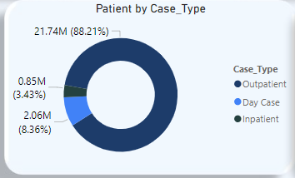


Surgical Outcomes
Day Case (8.36%):Total: 2.06 million patients.
These are patients who are admitted to the hospital for
procedures or treatments that do not require an overnight stay.
Common examples include minor surgeries.
Outpatient (88.21%):Total: 21.74 million patients.
These are patients who visit the hospital for diagnosis,
treatment, or consultations but do not require overnight
admission.
Inpatient (3.43%):Total: 0.85 million patients.
Inpatients are those who require admission to the hospital for an extended stay, typically for major surgeries, severe illnesses, or conditions requiring continuous monitoring and treatment.

Slide 10

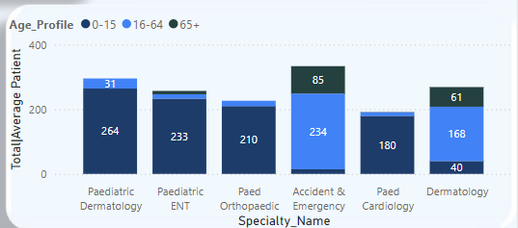
Stacked Column Chart
The Stacked Column Chart provides a comprehensive view
of the total number of patients based on their medical specialty,
while further segmenting the data by age profile
(e.g., Children, Adults, Seniors).

